Slide 1
Unit 03 Virtualization

Slide 2
Virtualization
Virtualization is Nothing but Creating Virtual Version of Something, in Computer Terms it can be OS, Storage Device, Network Resources.

Slide 3
Virtualization
Virtualization is the ability to run multiple operating systems on a single physical system and share the underlying hardware resources.
It is the process by which one computer hosts the appearance of many computers.
Virtualization is used to improve IT throughput and costs by using physical resources as a pool from which virtual resources can be allocated.
With VMware virtualization solutions we can reduce IT costs while increasing the efficiency, utilization and flexibility of their existing computer hardware.

Slide 4
Need for virtualization
Virtualization is the ability which allows sharing the physical instance of a single application or resource among multiple organizations or users.
This technique is done by assigning a name logically to all those physical resources & provides a pointer to those physical resources based on demand.
Over an existing operating system & hardware, we generally create a virtual machine which and above it we run other operating systems or applications. This is called Hardware Virtualization.
The virtual machine provides a separate environment that is logically distinct from its underlying hardware.
Here, the system or the machine is the host & virtual machine is the guest machine.
This virtual environment is managed by a firmware which is termed as a hypervisor.

Slide 5
Difference Between Virtualization and Cloud
Essentially there is a gap between these two terms, though cloud technology requires the concept of virtualization.
Virtualization is a technology - it can also be treated as software that can manipulate hardware.
Whereas cloud computing is a service which is the result of the manipulation.
Virtualization is the foundation element of cloud computing whereas Cloud technology is the delivery of shared resources as a service-on-demand via the internet.
Cloud is essentially made-up from the concept of virtualization.

Slide 6
Advantages of Virtualization
The number of servers gets reduced by the use of virtualization concept
Improve the ability of technology
The business continuity also raised due to the use of virtualization
It creates a mixed virtual environment
Increase efficiency for development & test environment
Lower Total Cost of Ownership (TCO)

Slide 7
Features of Virtualization
Partitioning: Multiple virtual servers can run on a physical server at the same time
Encapsulation of data: All data on the virtual server including boot disks is encapsulated in a file format
Isolation: The Virtual server running on the physical server are safely separated & don't affect each other
Hardware Independence: When the virtual server runs, it can migrate to the different hardware platform

Slide 8
Virtualization Architecture
A Virtual machine (VM) is an isolated runtime environment (guest OS and applications) Multiple virtual systems (VMs) can run on a single physical system.

Slide 9
Virtualization Architecture
Before Virtualization :
Single OS image per machine
Software and hardware tightly coupled
Running multiple applications on same machine often creates conflict
Inflexible and costly infrastructure
After virtualization :
Hardware-independence of operating system and applications
Virtual machines can be provisioned to any system
Can manage OS and application as a single unit by encapsulating them into virtual Machines

Slide 10
Benefits of Virtualization
Sharing of resources helps cost reduction.
Isolation: Virtual machines are isolated from each other as if they are physically separated.
Encapsulation: Virtual machines encapsulate a complete computing environment.
Hardware Independence: Virtual machines run independently of underlying hardware.
Portability: Virtual machines can be migrated between different hosts.

Slide 11
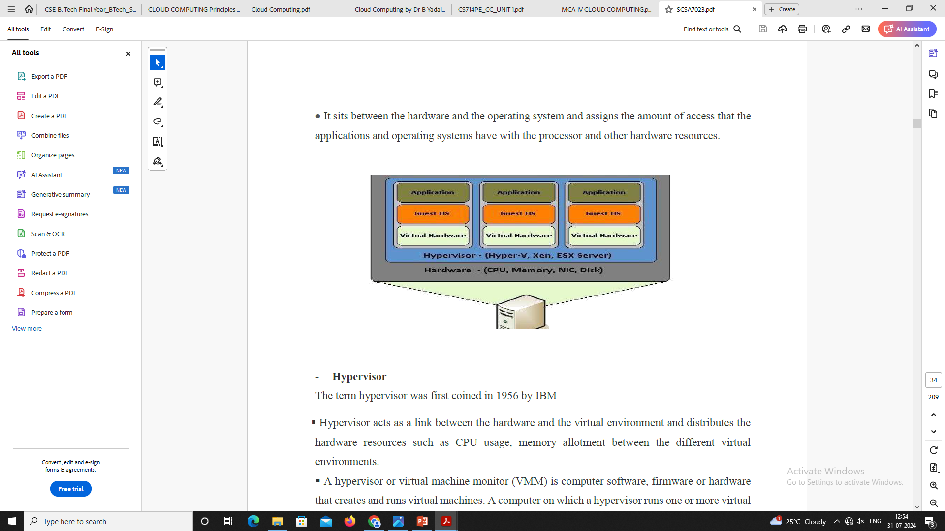
What makes virtualization possible?
There is a software that makes virtualization possible. This software is known as a Hypervisor, also known as a virtualization manager.
It sits between the hardware and the operating system and assigns the amount of access that the applications and operating systems have with the processor and other hardware resources.

Slide 12
Hypervisor
The term hypervisor was first coined in 1956 by IBM
Hypervisor acts as a link between the hardware and the virtual environment and distributes the hardware resources such as CPU usage, memory allotment between the different virtual environments.

Slide 13
Hypervisor
A hypervisor or virtual machine monitor (VMM) is computer software, firmware or hardware that creates and runs virtual machines.
A computer on which a hypervisor runs one or more virtual machines is called a host machine, and each virtual machine is called a guest machine.
A hypervisor is a hardware virtualization technique that allows multiple guest operating systems (OS) to run on a single host system at the same time.
The guest OS shares the hardware of the host computer, such that each OS appears to have its own processor, memory and other hardware resources.
A hypervisor is also known as a virtual machine manager (VMM).

Slide 14
Types of virtualization
The 7 Types of Virtualization
Hardware Virtualization.
Software Virtualization.
Network Virtualization.
Storage Virtualization
Memory Virtualization.
Data Virtualization.
Desktop Virtualization.

Slide 15
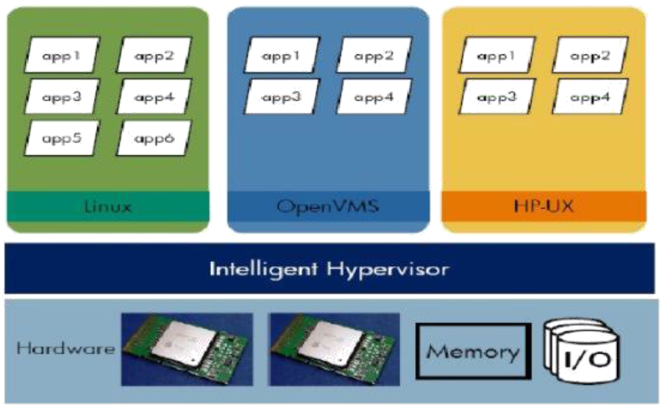
Hardware Virtualization
Hardware or platform virtualization means creation of virtual machine that act like real computer.
Ex. Computer running Microsoft Windows 7 may host the virtual machine look like a Ubuntu

Slide 16
Hardware Virtualization
Hardware virtualization also knows as hardware-assisted virtualization or server virtualization.
The basic idea of the technology is to combine many small physical servers into one large physical server, so that the processor can be used more effectively and efficiently.
Each small server can host a virtual machine, but the entire cluster of servers is treated as a single device by any process requesting the hardware.
The hardware resource allotment is done by the hypervisor.
The advantages are increased processing power as a result of maximized hardware utilization and application uptime.

Slide 17
Hardware Virtualization
Hardware virtualization is further subdivided into the following types
Full Virtualization – Guest software does not require any modifications since the underlying hardware is fully simulated.
Para Virtualization – The hardware is not simulated and the guest software run their own isolated domains.
Partial Virtualization – The virtual machine simulates the hardware and becomes independent of it. The guest operating system may require modifications.

Slide 18
Software Virtualization
The ability to computer to run and create one or more virtual environments.
It is used to enable a computer system in order to allow a guest OS to run.
Ex. Linux to run as a guest that is natively running a Microsoft Windows OS.

Slide 19
Software Virtualization
Subtypes:
Operating System Virtualization – Hosting multiple OS on the native
Application Virtualization – Hosting individual applications in a virtual environment separate from the native OS
Service Virtualization – Hosting specific processes and services related to a particular application

Slide 20
Network Virtualization
It refers to the management and monitoring of a computer network as a single managerial entity from a single software-based administrator’s console.
Multiple sub-networks can be created on the same physical network, which may or may not is authorized to communicate with each other.
It allows network optimization of data transfer rates, scalability, reliability, flexibility, and security.

Slide 21
Network Virtualization
Subtypes:
Internal network: Enables a single system to function like a network
External network: Combine many networks, or parts of networks into a virtual unit

Slide 22
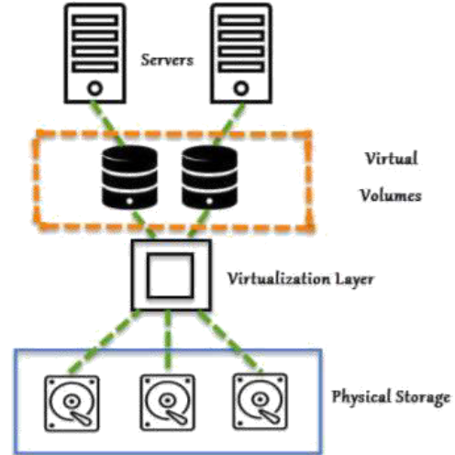
Storage Virtualization
Multiple physical storage devices are grouped together, which look like a single storage device.
Ex. Partitioning our hard drive into multiple partitions
Advantages
Improved storage management in a heterogeneous IT environment
Easy updates, better availability
Reduced downtime
Better storage utilization
Automated management

Slide 23
Storage Virtualization
Two types:
Block- Multiple storage devices are consolidated into one
File- Storage system grants access to files that are stored over multiple hosts

Slide 24
Memory Virtualization
The way to decouple memory from the server to provide a shared, distributed or networked function.
It enhances performance by providing greater memory capacity without any addition to the main memory.

Slide 25
Memory Virtualization
Implementations
Application-level integration – Applications access the memory pool directly

Slide 26
Memory Virtualization
Implementations
Operating System Level Integration – Access to the memory pool is provided through an operating system

Slide 27
Data Virtualization
Without any technical details, we can easily manipulate data and know how it is formatted or where it is physically located.
It decreases the data errors and workload
The data is presented as an abstract layer completely independent of data structure and database systems
The user’s desktop is stored on a remote server, allowing the user to access his/her desktop from any device or location.
It provides the work convenience and security
It provides a lot of flexibility for employees to work from home or on the go
Since the data transfer takes place over secure protocols, any risk of data theft is minimized

Slide 28
Virtualization Technology
Virtualization is possible through a wide range of Technologies which are available to use and are also Open Source.
XEN
KVM

Slide 29
Xen Hypervisor
Xen Hypervisor Xen is a type-1 hypervisor, providing services that allow multiple computer operating systems to execute on the same computer hardware concurrently.
It was developed by the University of Cambridge.
Now being developed by the Linux Foundation with support from Intel.
Xen is a hypervisor that enables the simultaneous creation, execution and management of multiple virtual machines on one physical computer.

Slide 30
Xen Hypervisor
Xen was developed by XenSource, which was purchased by Citrix Systems in 2007.
Xen was first released in 2003.
It is an open source hypervisor.
It also comes in an enterprise version.
Because it's a type-1 hypervisor, Xen controls, monitors and manages the hardware, peripheral and I/O resources directly.
Guest virtual machines request Xen to provision any resource and must install Xen virtual device drivers to access hardware components.
Xen supports multiple instances of the same or different operating systems with native support for most operating systems, including Windows and Linux.
Moreover, Xen can be used on x86, IA-32 and ARM processor architecture.

Slide 31
Xen Hypervisor

Slide 32
KVM
Kernel-based Virtual Machine (KVM) is an open source virtualization technology built into Linux®.
Specifically, KVM lets we turn Linux into a hypervisor that allows a host machine to run multiple, isolated virtual environments called guests or virtual machines (VMs).
KVM is part of Linux.
If we’ve got Linux 2.6.20 or new, we’ve got KVM.
KVM was first announced in 2006 and merged into the mainline Linux kernel version a year later. Because KVM is part of existing Linux code, it immediately benefits from every new Linux feature, fix, and advancement without additional engineering.

Slide 33
How does KVM work?
KVM converts Linux into a type-1 (bare-metal) hypervisor.
All hypervisors need some operating system-level components—such as a memory manager, process scheduler, input/output (I/O) stack, device drivers, security manager, a network stack, and more—to run VMs.
KVM has all these components because it’s part of the Linux kernel.
Every VM is implemented as a regular Linux process, scheduled by the standard Linux scheduler, with dedicated virtual hardware like a network card, graphics adapter, CPU(s), memory, and disks.

Slide 34
Implementing KVM
We need to have to run a version of Linux that was released after 2007 and it needs to be installed on X86 hardware that supports virtualization capabilities.
If both of those boxes are checked, then all we have to do is load 2 existing modules (a host kernel module and a processor-specific module), an emulator, and any drivers that will help we run additional systems.
But implementing KVM on a supported Linux distribution—like Red Hat Enterprise Linux—expands KVM's capabilities, letting we swap resources among guests, share common libraries, optimize system performance, and a lot more.

Slide 35
KVM features
Security
KVM uses a combination of security-enhanced Linux (SELinux) and secure virtualization (sVirt) for enhanced VM security and isolation.
SELinux establishes security boundaries around VMs.
sVirt extends SELinux’s capabilities, allowing Mandatory Access Control (MAC) security to be applied to guest VMs and preventing manual labeling errors.
Storage
KVM is able to use any storage supported by Linux, including some local disks and network-attached storage (NAS).
Multipath I/O may be used to improve storage and provide redundancy.
KVM also supports shared file systems so VM images may be shared by multiple hosts.
Disk images support thin provisioning, allocating storage on demand rather than all up front.

Slide 36
Interpretation and Binary Translation
Interpretation
simple and easy to implement, portable
low performance
threaded interpretation
Binary translation
complex implementation
high initial translation cost, small execution cost
selective compilation

Slide 37
Interpretation and Binary Translation
Interpreter state:
An interpreter needs to maintain the complete, architected state of the machine implementing the source ISA registers& memory(code, data, stack)

Slide 38
Interpretation and Binary Translation
Decode and dispatch interpreter:
step through the source program one instruction at a time
decode the current instruction
dispatch to corresponding interpreter routine
very high interpretation cost

Slide 39
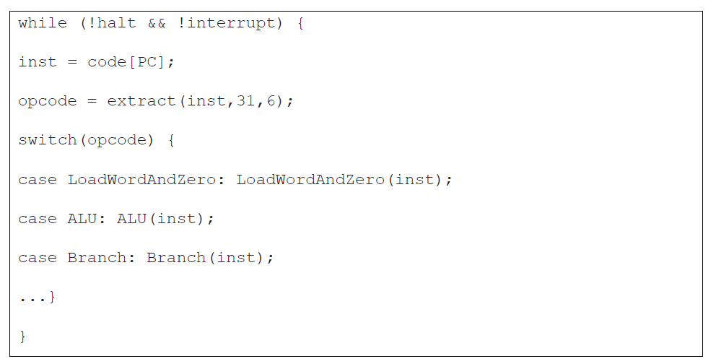
Interpretation and Binary Translation

Slide 40
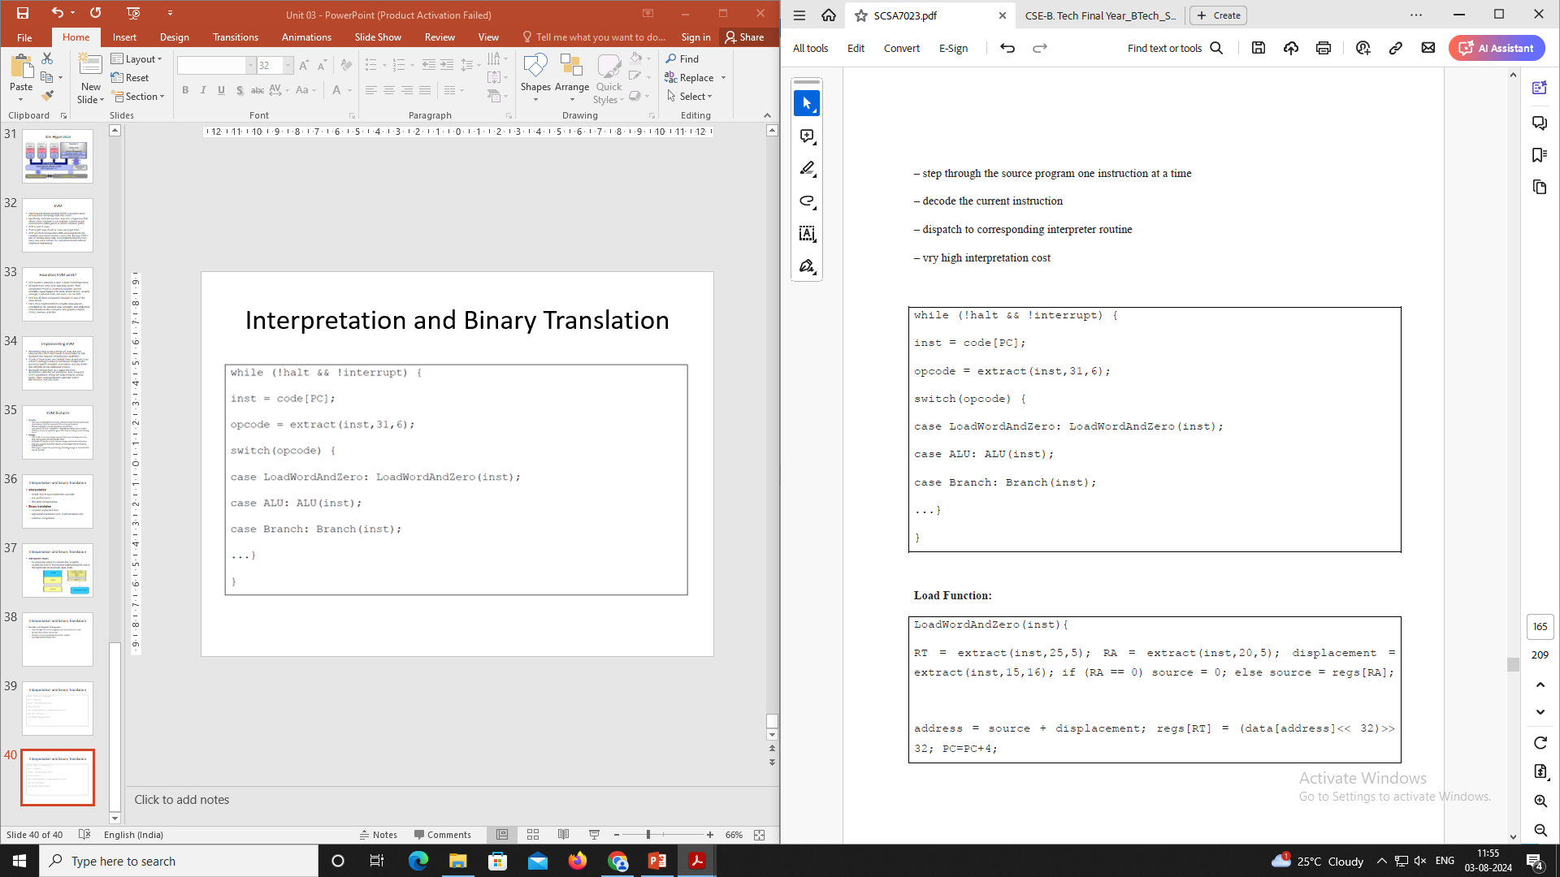
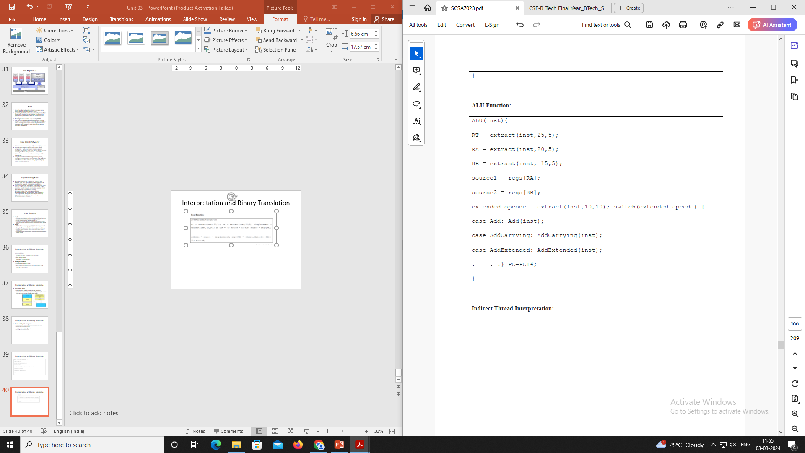
Interpretation and Binary Translation

Slide 41
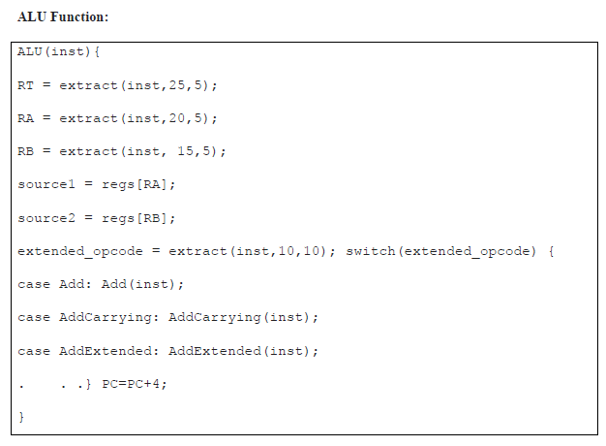
Interpretation and Binary Translation

Slide 42
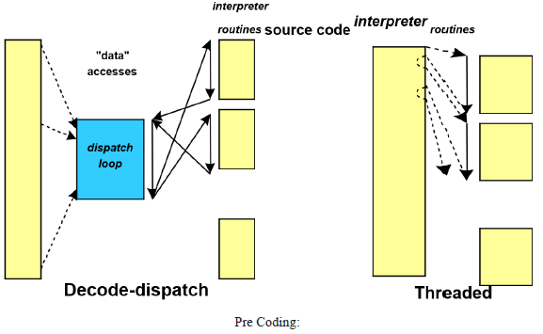
Interpretation and Binary Translation
Indirect Thread Interpretation:
Parse each instruction into a pre-defined structure to facilitate interpretation
Separate opcode, operands, etc.
reduces shifts / masks significantly
more useful for CICS ISAs

Slide 43

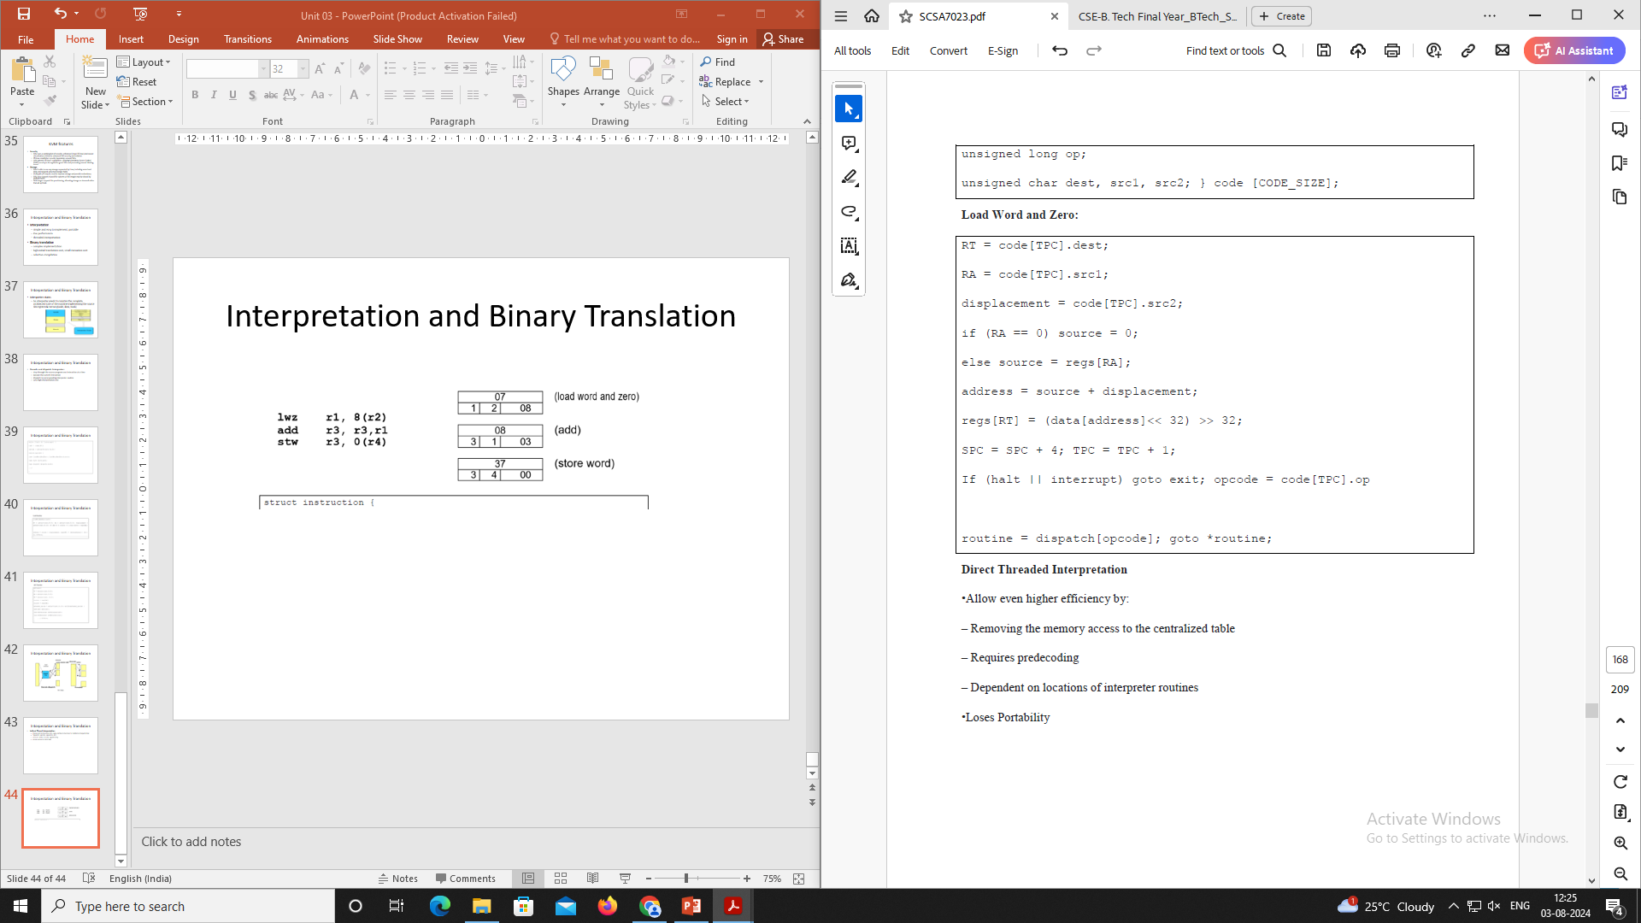
Interpretation and Binary Translation

Slide 44
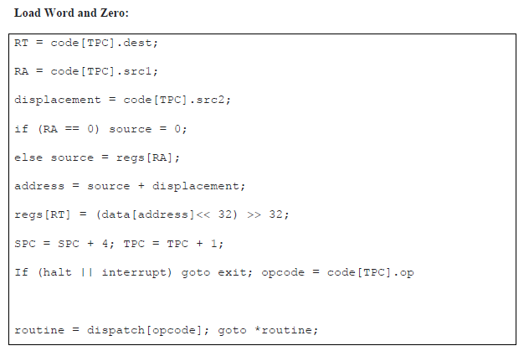
Interpretation and Binary Translation

Slide 45
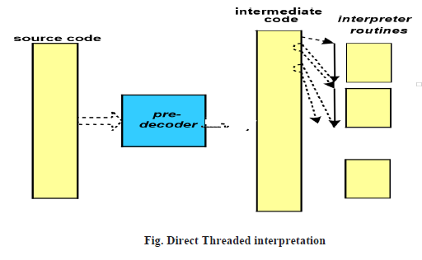
Interpretation and Binary Translation
Direct Threaded Interpretation
Allow even higher efficiency by:
Removing the memory access to the centralized table
Requires predecoding
Dependent on locations of interpreter routines
Loses Portability

Slide 46
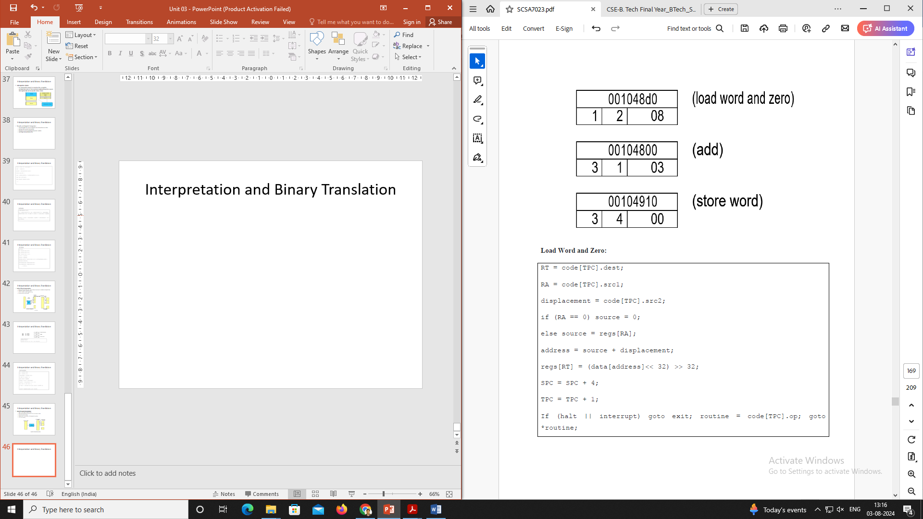
Interpretation and Binary Translation

Slide 47
Interpretation and Binary Translation
Interpreter control flow:
Decode for CISC ISA
Individual routines for each instruction

Slide 48
Interpretation and Binary Translation
Interpreter control flow:
For CISC ISAs
multiple byte opcode
make common cases fast

Slide 49
Interpretation and Binary Translation
Binary Translation
Translate source binary program to target binary before execution
is the logical conclusion of predecoding
get rid of parsing and jumps altogether
allows optimizations on the native code
achieves higher performance than interpretation
needs mapping of source state onto the host state (state mapping)

Slide 50
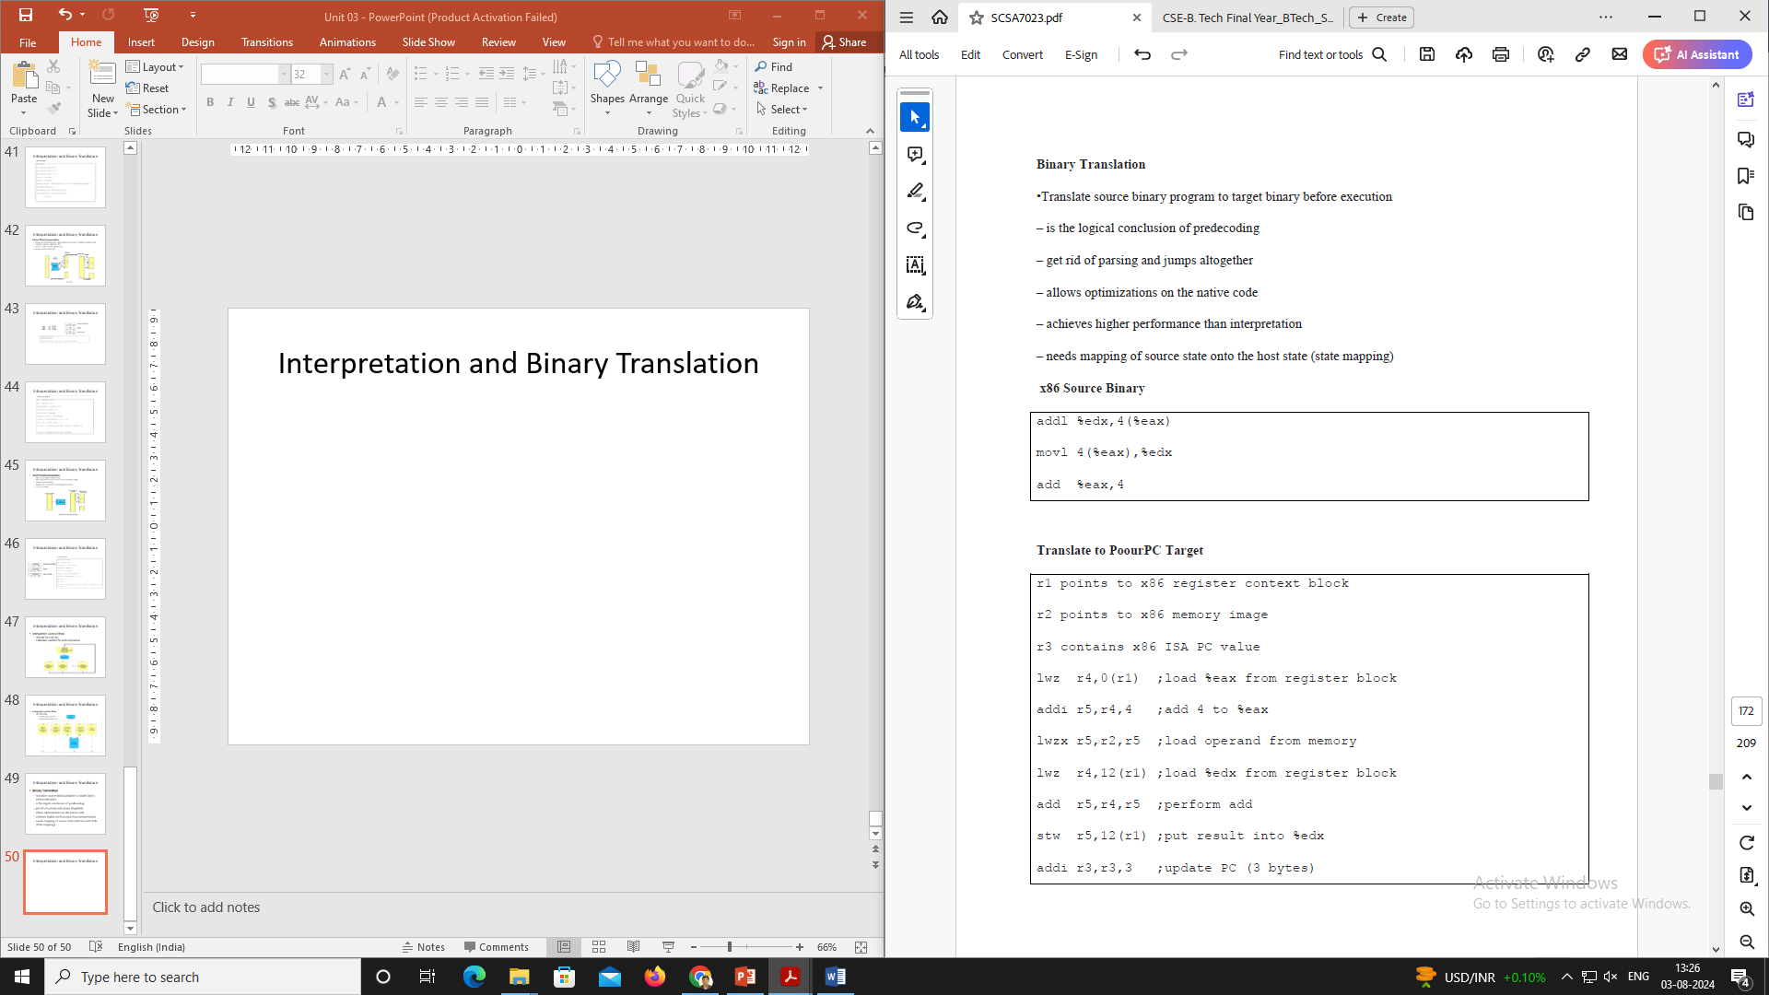

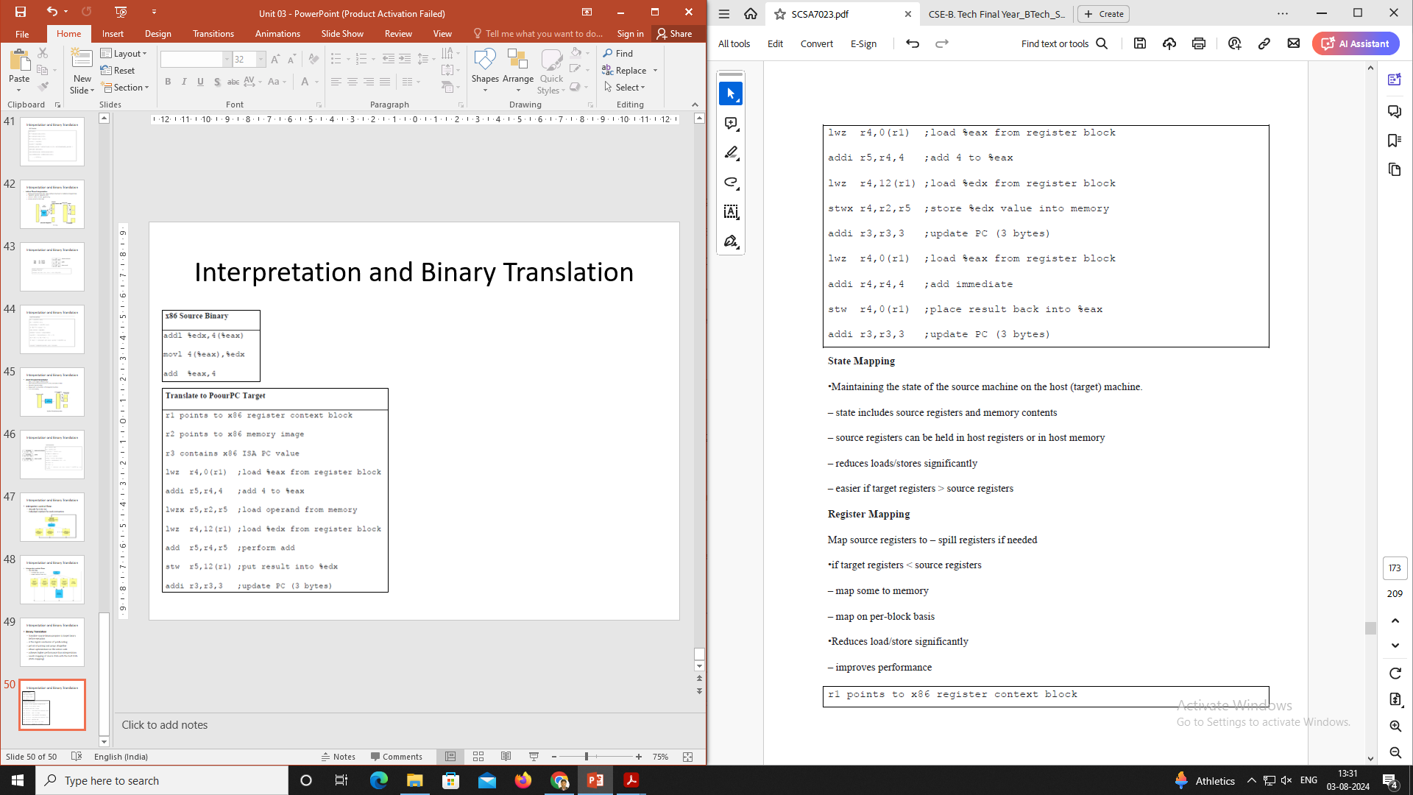
Interpretation and Binary Translation

Slide 51
Interpretation and Binary Translation
State Mapping
Maintaining the state of the source machine on the host (target) machine.
state includes source registers and memory contents
source registers can be held in host registers or in host memory
reduces loads/stores significantly
easier if target registers > source registers
Register Mapping
Map source registers to – spill registers if needed
if target registers < source registers
map some to memory
map on per-block basis
Reduces load/store significantly
improves performance

Slide 52
Binary Translation with Full Virtualization
Depending on implementation technologies, hardware virtualization can be classified into two categories:
Full virtualization
Host-based virtualization
Full virtualization does not need to modify the host OS.
It relies on binary translation to trap and to virtualize the execution of certain sensitive, non virtualizable instructions.
The guest OSes and their applications consist of noncritical and critical instructions.
In a host-based system, both a host OS and a guest OS are used.
A virtualization software layer is built between the host OS and guest OS.
These two classes of VM architecture are introduced next.

Slide 53
Binary Translation with Full Virtualization
1. Full Virtualization
With full virtualization, noncritical instructions run on the hardware directly while critical instructions are discovered and replaced with traps into the VMM to be emulated by software.
Both the hypervisor and VMM approaches are considered full virtualization.
Why are only critical instructions trapped into the VMM? This is because binary translation can incur a large performance overhead.
Noncritical instructions do not control hardware or threaten the security of the system, but critical instructions do.
Therefore, running noncritical instructions on hardware not only can promote efficiency, but also can ensure system security.

Slide 54
Binary Translation with Full Virtualization
1. Full Virtualization
With full virtualization, noncritical instructions run on the hardware directly while critical instructions are discovered and replaced with traps into the VMM to be emulated by software.
Both the hypervisor and VMM approaches are considered full virtualization.
Why are only critical instructions trapped into the VMM? This is because binary translation can incur a large performance overhead.
Noncritical instructions do not control hardware or threaten the security of the system, but critical instructions do.
Therefore, running noncritical instructions on hardware not only can promote efficiency, but also can ensure system security.

